Slide 1
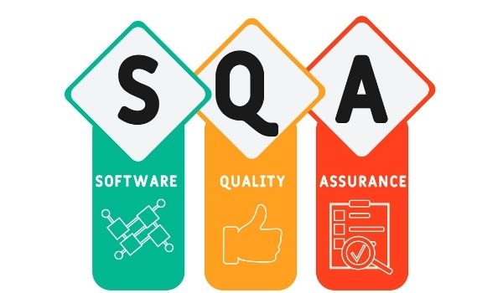

Slide 2
Software Quality Assurance
Software Quality Assurance (SQA) is a process that assures that all software engineering processes, methods, activities, and work items are monitored and comply with the defined standards. These defined standards could be one or a combination of anything like ISO 9000, CMMI model, ISO15504, etc.
It involves monitoring and improving the entire software development process.
SQA is crucial for delivering high-quality software by preventing and identifying defects early in the development process.
It helps in meeting customer expectations, reducing costs, and ensuring compliance with standards.

Slide 3
Software Quality Assurance (SQA) Techniques
1. Audits
Audits involve inspecting work products and related information to determine whether they follow standard processes.
2. Review
A meeting where a software product is reviewed by internal and external stakeholders and comments and approvals are collected.
3. Simulation
A simulation is a tool that models real-life situations to virtually study the behaviour of the system under study.

Slide 4
Software Quality Assurance (SQA) Techniques (cont’d)
4. Functional Testing
A QA technique checks what the system is doing without considering how the system works. This type of black box testing is primarily focused on testing system specifications or functionality.
5. Code inspection
This is the most formal type of review, running static tests to find bugs and prevent them from escalating at a later stage. It is performed by trained mediators/peers and is based on rules, checklists,
6. Static Analysis
Software analysis is performed by automated tools without actually running the program. This technique is commonly used for medical, nuclear, and aerospace software quality assurance. Software metrics and reverse engineering are common forms of static analysis.

Slide 5
Software Quality Assurance (SQA) Techniques (cont’d)
7. Walkthroughs
Software or code walkthroughs guide developers to explore a product, ask questions, suggest alternatives, and comment on possible bugs, standards violations, or other issues by guiding members of the development team. A type of peer review that you provide.
8. Six Sigma
Six Sigma is a quality assurance approach aimed at near-perfect products or services. It is widely used in many fields, including software. The main goal of Six Sigma is to improve the process so that the software produced is 99.76% error-free.

Slide 6
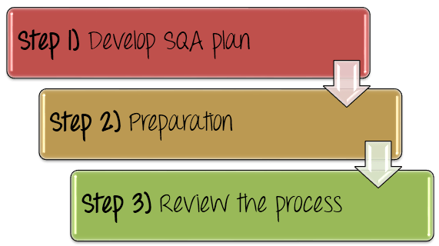
How to implement the quality assurance?

Slide 7
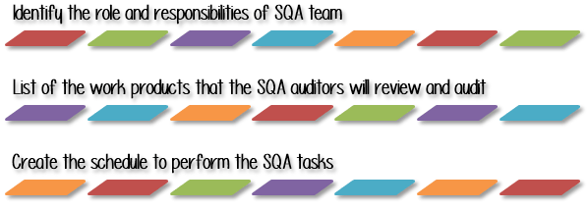
Develop SQA Plan
The goal of SQA plan is to craft planning processes and procedures to ensure products manufactured, or the service delivered by the organization are of exceptional quality.
In the SQA Plan, the Test Manager should do as following

Slide 8
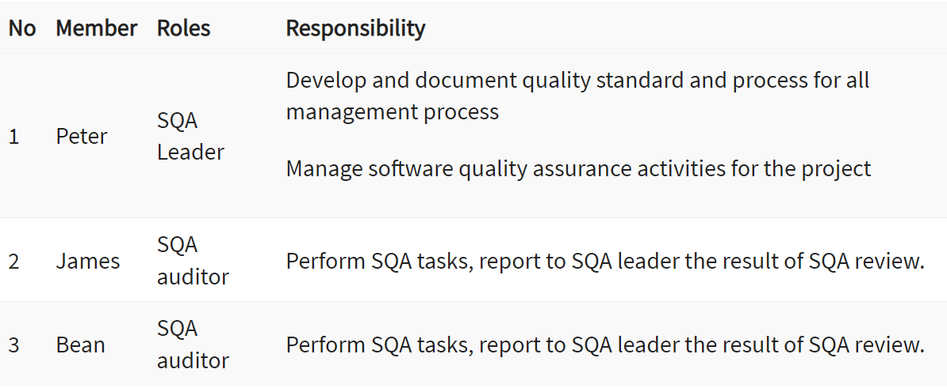
Develop SQA Plan (cont’d)
Identify the role and responsibilities of SQA team
The SQA team is the group of person who plays the major role in the project. Without QA, no business will run successfully. Therefore, the Test Manager has to make clear the responsibility of each SQA member in SQA plan .

Slide 9
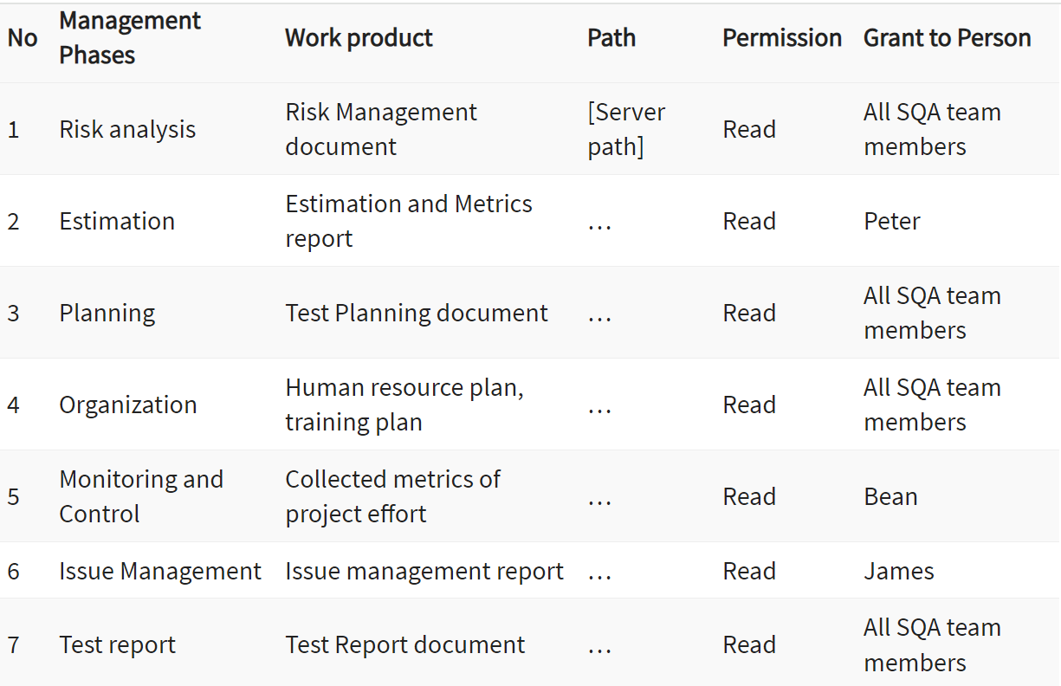
Develop SQA Plan (cont’d)
List of the work products that the SQA auditor will review and audit
The Test Manager should
List out all the work products of each Test Management Process
Define which facilities or equipment the SQA auditor can access to perform SQA tasks such as process evaluations and audits.

Slide 10
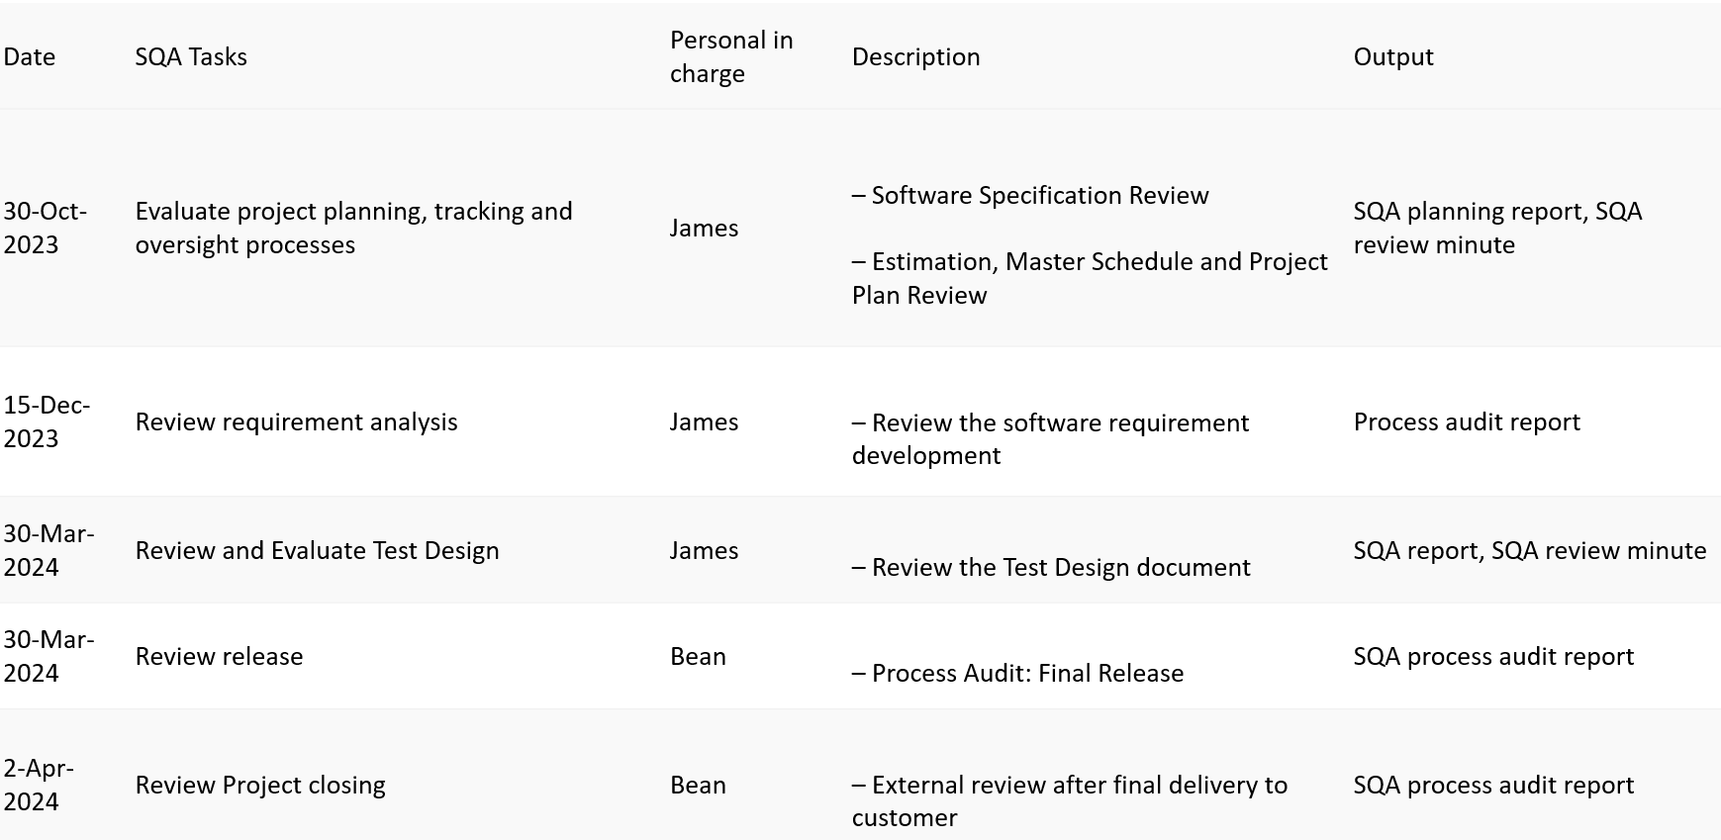
Develop SQA Plan (cont’d)
Create the schedule to perform the SQA tasks
The Test Manager should describe the tasks to be performed by SQA auditor with special emphasis on SQA activities .
Test Manager also creates the scheduling of those SQA tasks.

Slide 11
SQA preparation : Define the standards/methodology
To review the Management activities against the standards process, you should do the following steps
Define the policies and procedures intended to prevent defects from occurring in the management process
Document the policies & procedures
Inform and train the staff to use it

Slide 12
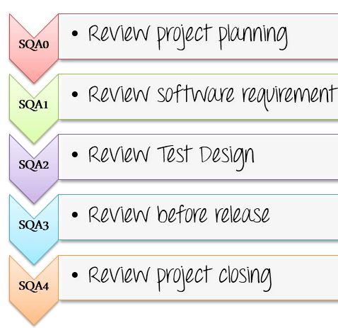
Review the process
Review project activities to verify compliance with the defined management process. In the management review, the SQA members have to perform 5 SQA reviews.
In each SQA phase, the SQA members provide consultation and review of the project plans, work product, and procedures regarding compliance to defined organizational policy and standard procedures.

Slide 13
SQA review checklist
SOFTWARE QUALITY ASSURANCE ACTIVITIES | Yes | No | N/A
I. Risk Management
Risk are recorded and prioritized | X
The countermeasure to avoid risk must be defined |  | X
II. Test Estimation
Project tasks are break out into work product for estimation | X
The estimation must be approved by Manager
III. Test Planning
Test test scope and Test objective are defined | X
Test Planning are documented
IV. Test Organization
Resource for Testing are defined | X
Project members and their roles in project are defined | X
V. Project Monitoring
The Test Manager monitor the Project by collecting metrics from members | X
All the metrics of project must be collected and documented | X
VI. Issues Management
Any issues happened in the project must be reported to management board | X
The countermeasure for the issues must be defined and approved |  | X
VII. Test report
The test report must be documented | X
The result must be acknowledged and approved by Manager |  | X
VIII. REVIEWS and AUDITS
SQA reviews and audits are documented. | X
Process SQA reviews occur. | X
SQA reviews of the work product are performed. | X
SQA activities are reported to the project manager. | X

Slide 14
Overview of SQA Activities at each SDLC stage
Software Quality Assurance (SQA) activities are crucial throughout the Software Development Life Cycle (SDLC) to ensure that the software product meets the specified requirements and quality standards.
1. Requirements Gathering and Analysis:
Review documents: Check for clarity, completeness, consistency, and feasibility.
Identify risks and areas for improvement: Analyze potential user pain points, technical challenges, and compliance requirements.
Verify alignment with user needs and business objectives: Ensure requirements accurately reflect user expectations and contribute to organizational goals.

Slide 15
Overview of SQA Activities at each SDLC stage
2. Design Review and Inspection:
Analyze design efficiency: Assess usability, performance, maintainability, and scalability of the proposed design.
Identify design flaws: Check for inconsistencies, missing elements, or user interface complexities.
Suggest improvements: Recommend alternative design solutions or optimizations based on best practices.

Slide 16
Overview of SQA Activities at each SDLC stage
3. Development:
Code Review: Manually examine code for syntax errors, logic flaws, security vulnerabilities, and adherence to coding standards.
Static Code Analysis: Utilize automated tools to detect potential issues like dead code, code smells, and security vulnerabilities.
Unit Testing: Write and execute tests for individual units of code to verify their functionality and behaviour.
4. Testing:
Integration Testing: Test how different modules work together to ensure seamless flow and data exchange.
System Testing: Evaluate the overall functionality, performance, and compatibility of the complete system.
Acceptance Testing: Involve users or stakeholders to confirm the software meets their expectations and requirements.

Slide 17
Overview of SQA Activities at each SDLC stage
5. Deployment:
Plan and coordinate release: Define roll-out strategies, rollback procedures, and communication plans.
Monitor performance and user feedback: Track key metrics, identify potential issues, and address user concerns promptly.
Patch management and post-release support: Maintain and deliver fixes for any bugs or issues discovered after deployment.
6. Maintenance:
Regression testing: Ensure new changes haven't introduced regressions or unintended consequences.
Defect tracking and resolution: Continue addressing any outstanding or newly identified issues.
Continuous improvement: Analyze metrics, gather feedback, and implement new SQA practices and tools to optimize the process.

Slide 18
Advantages of SQA
Software will have fewer latent defects, resulting in reduced effort and time spent during testing and maintenance
Higher reliability will result in greater customer satisfaction
Maintenance costs can be reduced
Overall life cycle cost of software is reduced

Slide 19
Disadvantages of SQA
It is difficult to institute in small organizations, where available resources to perform necessary activities are not available
It represents cultural change - and change is never easy
It requires the expenditure of dollars that would not otherwise be explicitly budgeted to software engineering or QA

Slide 20
Review Checklist for Systems Engineering
Are major functions defined in a bounded and unambiguous fashion?
Are interfaces between system elements defined?
Are performance bounds established for the system as a whole and for each element?
Are design constraints established for each element?
Has the best alternative been selected?
Is the solution technologically feasible?
Has a mechanism for system validation and verification been established?
Is there consistency among all system elements?

Slide 21
Review Checklist for Software Project Planning
Is the software scope unambiguously defined and bounded?
Is terminology clear?
Are resources adequate for the scope?
Are resources readily available?
Are tasks properly defined and sequenced?
Is the basis for cost estimation reasonable? Has it been developed using two different sources?
Have historical productivity and quality data been used?
Have differences in estimates been reconciled?
Are pre-established budgets and deadlines realistic?
Is the schedule consistent?

Slide 22
Review Checklist for Software Requirements Analysis
Is the information domain analysis complete, consistent, and accurate?
Is problem partitioning complete?
Are external and internal interfaces properly defined?
Are all requirements traceable to the system level?
Is prototyping conducted for the customer?
Is performance achievable with constraints imposed by other system elements?
Are requirements consistent with schedule, resources, and budget?
Are validation criteria complete?

Slide 23
Review Checklist for Software Design (Preliminary Design Review)
Are software requirements reflected in the software architecture?
Is effective modularity achieved? Are modules functionally independent?
Is program architecture factored?
Are interfaces defined for modules and external system elements?
Is data structure consistent with software requirements?
Has maintainability been considered?

Slide 24
Review Checklist for Software Design (Design Walkthrough)
Does the algorithm accomplish the desired function?
Is the algorithm logically correct?
Is the interface consistent with architectural design?
Is logical complexity reasonable?
Have error handling and “antibugging” been specified?
Is local data structure properly defined?
Are structured programming constructs used throughout?
Is design detail amenable to the implementation language?
Which are used: operating system or language dependent features?
Is compound or inverse logic used?
Has maintainability been considered?

Slide 25
Review Checklist for Coding
Is the design properly translated into code? (The results of the procedural design should be available at this review)
Are there misspellings or typos?
Has proper use of language conventions been made?
Is there compliance with coding standards for language style, comments, module prologue?
Are incorrect or ambiguous comments present?
Are typing and data declaration proper?
Are physical constraints, correct?
Have all items on the design walkthrough checklist been reapplied (as required)?

Slide 26
Review Checklist for Software Testing (Test Plan)
Have major test phases been properly identified and sequenced?
Has traceability to validation criteria/requirements been established as part of software requirements analysis?
Are major functions demonstrated early?
Is the test plan consistent with the overall project plan?
Has a test schedule been explicitly defined?
Are test resources and tools identified and available?
Has a test recordkeeping mechanism been established?
Have test drivers and stubs been identified, and has work to develop them been scheduled?
Has stress testing for software been specified?

Slide 27
Review Checklist for Software Testing (Test Procedure)
Have both white and black box tests been specified?
Have all independent logic paths been tested?
Have test cases been identified and listed with expected results?
Is error handling to be tested?
Are boundary values to be tested?
Are timing and performance to be tested?
Has acceptable variation from expected results been specified?

Slide 28
Review Checklist for Maintenance
Have side effects associated with change been considered?
Has the request for change been documented, evaluated, and approved?
Has the change, once made, been documented and reported to interested parties?
Have appropriate FTRs been conducted?
Has a final acceptance review been conducted to assure that all software has been properly updated, tested, and replaced?

Slide 29


Slide 30
References
https://www.guru99.com/software-quality-assurance-test-audit-review-makes-your-life-easy.html
https://www.geeksforgeeks.org/software-engineering-software-quality-assurance/
https://www.softwaretestinghelp.com/software-quality-assurance/
https://www.javatpoint.com/software-quality-assurance
https://www.shiksha.com/online-courses/articles/software-quality-assurance/

